Slide 1


Tree leaf recognition
Rufus Roisch & Hedda Bonatz Machine Learning with Tensorflow SoSe 2023

Slide 2
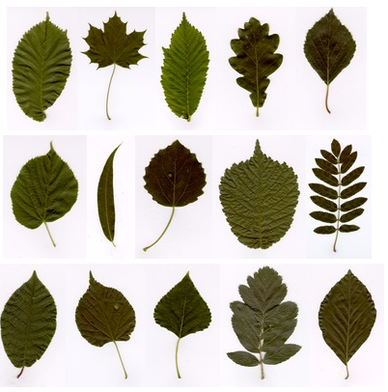
Data
15 tree leaf types with 75 images each → 1125 images
RGB images
Single leaf on a white background → Bias
Preprocessing:
Resize the images (300x150x3)
Shuffle and split into training and test data
→ Train: 900 | Test: 225
Söderkvist 2001
Notes:
Most freely available datasets look into plants in general and often the plants are not native in Germany
Dataset from a master thesis from the university of Linkoping covering tree leaves like the field elm and the cottonwood that are mostly native in the Northern Hemisphere, so also here in Germany

Slide 3
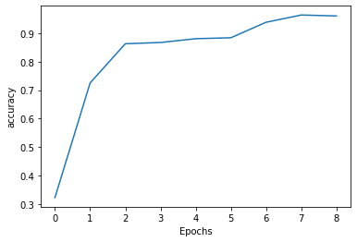
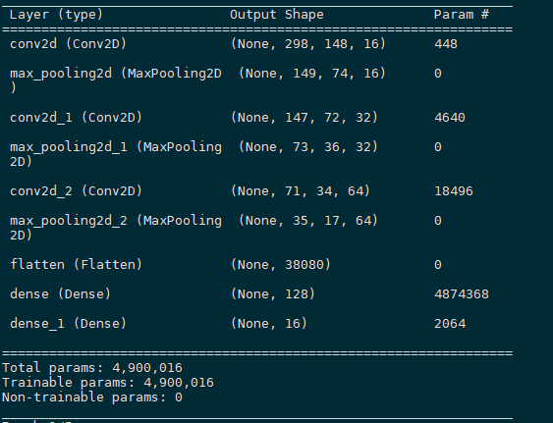
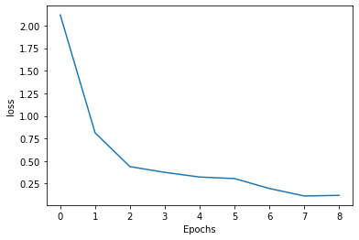
Basemodel
5 epochs
→ Validation loss: 0.5 | Validation accuracy: 0.88

Slide 4
Basemodel adjustments
Epochs | Convs | Pooling | Optimizer | Loss
5 | 3x (3x3 ) | 3x () | Adam | softmax
9 | 1x () | 1x () | Adam | softmax
9 | 2x | 2x () | Adam | softmax
9 | 3x () | 3x () | Adam | softmax
9 | 3x () | 3x () | Adam | softmax
Changes:
Epoch: For 9 epochs we get the best performance (Acc: 0.85 | Loss: 0.63) → for more epochs the model is overfitting
Number of layers (9 epochs):
1 Conv + 1 Pool: validation loss: 0.54 | validation accuracy: 0.83
2 Conv + 2 Pool: validation loss: 0.53 | validation accuracy: 0.89 → better
3 Conv + 3 Pool: validation loss: | validation accuracy: 0.9
4 Conv + 4 Pool: validation loss: 0.47 | validation accuracy: 0.87 (less epochs than 9 improve the performance again)
Performance improves with more layers
Increasing the size of max pooling decreases the accuracy
3x3 max pooling improves accuracy (validation loss. 0.34 | validation accuracy: 0.91)
Average pooling decreases the performance
Optimizer:

Slide 5
Color Changes
Color scheme | Validation loss | Validation accuracy | Run time
RGB
BW | 0.43 | 0.86 | 100s
HSV | 0.42 | 0.88 | 139s
Changing the color settings marginally influences the performance
Leafs have different colors depending on season and health status → HSV color scheme might be a good option
Notes:
Black and White:
Validation loss: 0.62 | Validation accuracy: 0.81 (5 epochs, max pool 2x2)
Validation loss: 0.43 | Validation accuracy: 0.86 (9 epochs, max pool 3x3)
HSV (Hue, Saturation, Value changes):
Separates color from brightness (more robust to changes in lighting conditions; better in detecting objects of different color; simplicity)
Validation loss: 0.64 | Validation accuracy: 0.82 (5 epochs, max pool 2x2)
Validation loss: 0.42 | Validation accuracy: 0.88 (9 epochs, max pool 3x3)

Slide 6
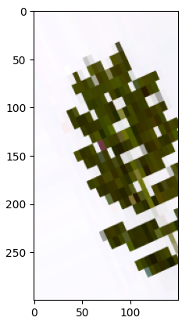
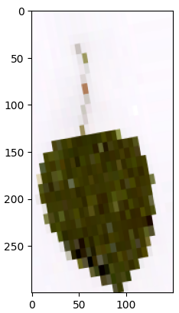
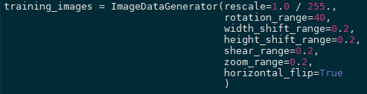
Augmentation
Massively degrades the performance of the model
Validation loss: ~ 2.5
Validation accuracy: ~ 0.1
Our dataset is already so neat and structured that augmentation is not reasonable

Slide 7
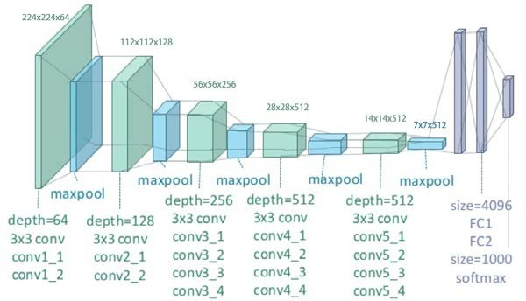
Transfer Learning with VGG19
Developed by the University of Oxford in 2014 (Simonyan & Zisserman)
Very deep CNN with more layers
Small convolution filters with size 3x3
Layers: 16 Convs, 3 dense, 5 max pool
Parameters: 143 M
Top-1 Accuracy: 74,4 %
Yang et al. 2018
Notes:
Top-1 Accuracy: Calculates the percentage of instances where the prediction matches the ground truth label for the class with the highest probability.

Slide 8
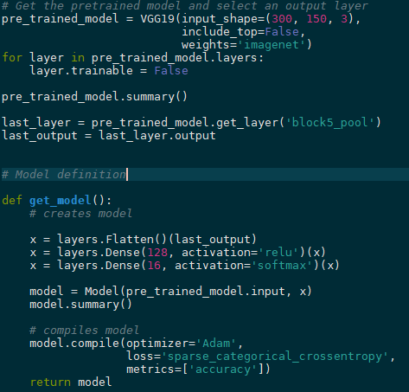
Implementation VGG19
Freezing the weights after the 5th pooling layer
Using the pooling layer as input for the flattened layer
Notes:
5 epochs

Slide 9
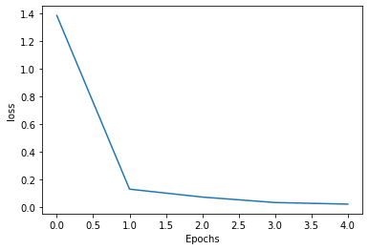
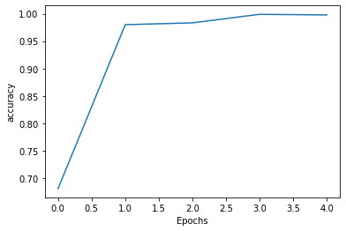
Implementation VGG19
Validation loss: 0.1
Validation accuracy: 0.97
→ Training the model is much slower: ~ 9 min/epoch vs 7 s/epoch
Notes:
5 epochs

Slide 10
Difficulties
Structured working
Setting up tensorflow on private machine (GPU not working)

Slide 11
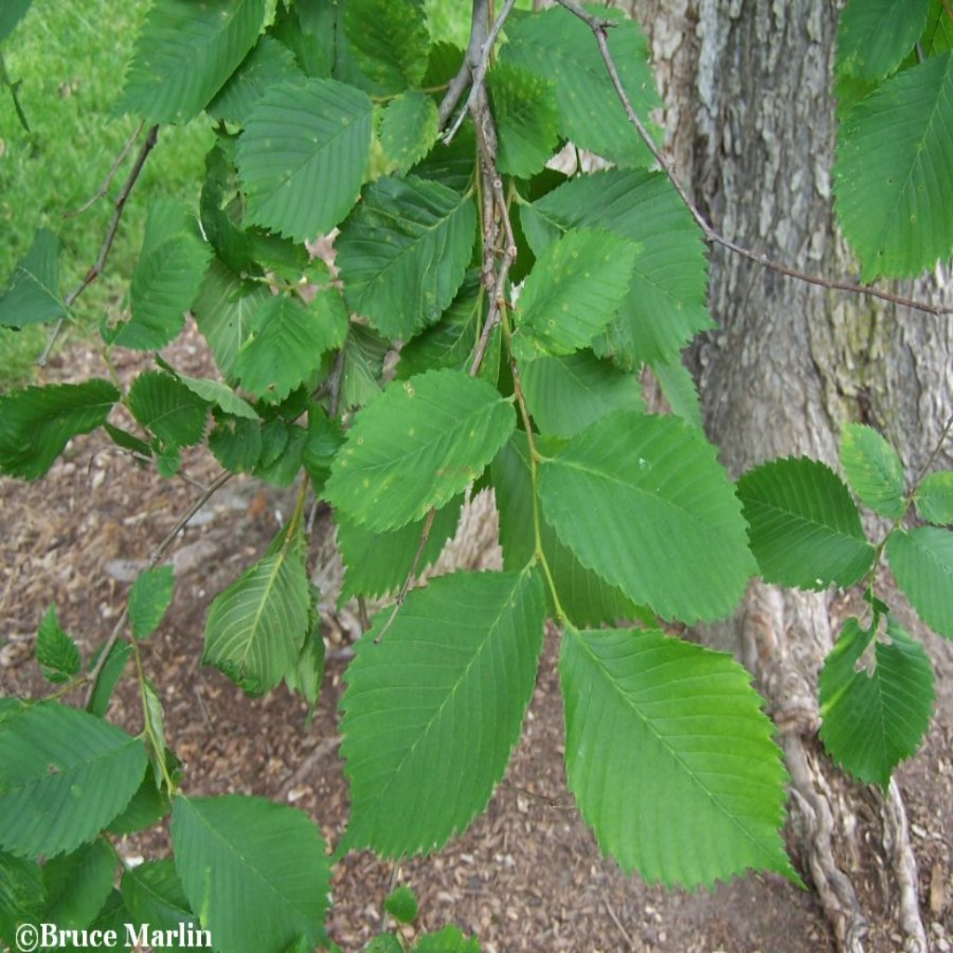
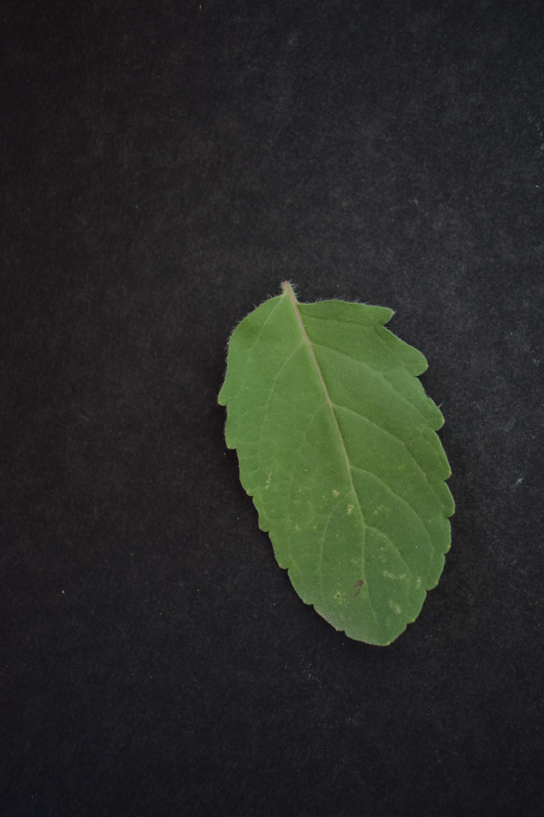
Outlook
Training and testing the model with a larger variety of images
tensorflow.org
kaggle.com

